Slide 1
Classical Machine Learning Approach for Human Activity Recognition Using Location Data
UbiComp/ISWC’21, September 21-26,2021
HASCA WORKSHOP 2021
Sussex-Huawei Locomotion Challenge 2021
GPU Kaj Kore Na
Paper ID- 1020
Team Members:
Safaeid Hossain Arib, University of Dhaka
Rabeya Akter, University of Dhaka
Omar Shahid, University of Dhaka
Md Atiqur Rahman Ahad, University of Dhaka

Slide 2
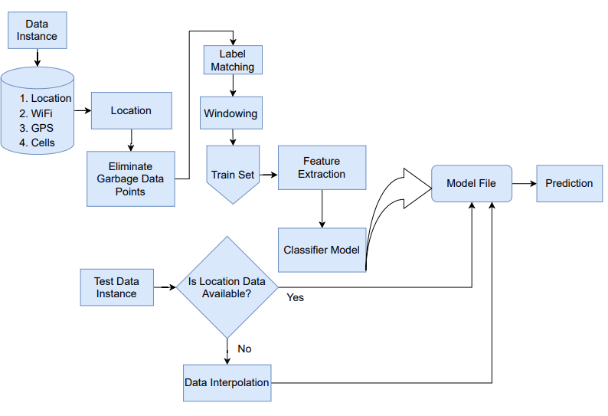
METHOD OVERVIEW

Slide 3
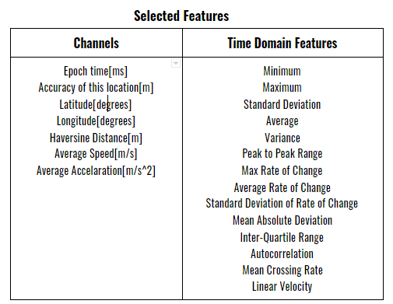
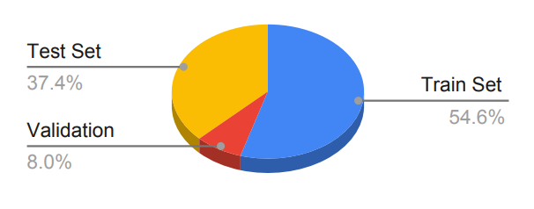
DATA PROCESSING
LIST OF FEATURES
Distribution of the Dataset

Slide 4
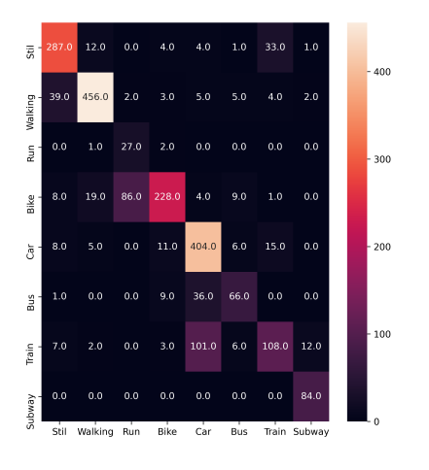
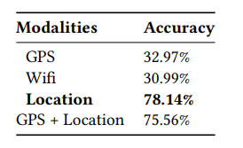
RESULTS
CONFUSION MATRIX
RESULT FOR DIFFERENT MODALITIES

Slide 5
THANK YOU

